Slide 1
Django
Manoj joshi

Slide 2
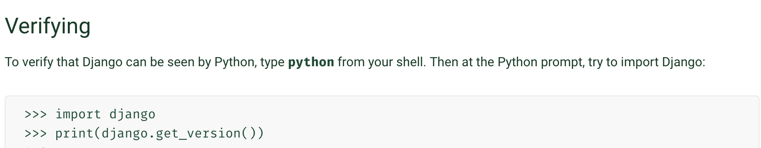
Installation
python -m pip install Django

Slide 3
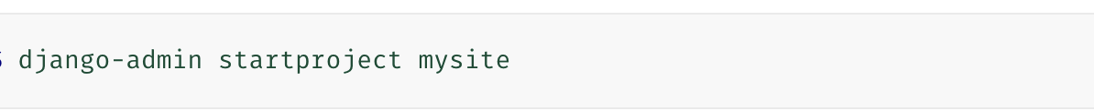
First Django Project
It creates a Django project i.e. a collection of settings for an instance of Django, including database configuration, Django-specific options and application-specific settings.
This will create a mysite directory in your current directory.

Slide 4
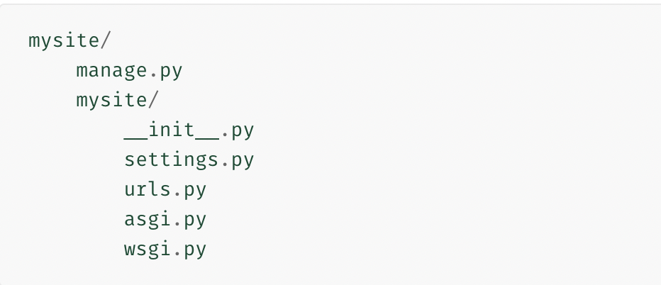
Let’s look at what startproject created:
The outer mysite/ root directory is a container for your project. Its name doesn’t matter to Django;
Manage.py: A command-line utility that lets you interact with this Django project in various ways. you can rename it to anything you like.
The inner mysite/ directory is the actual Python package for your project. Its name is the Python package name you’ll need to use to import anything inside it (e.g. mysite.urls).
mysite/__init__.py: An empty file that tells Python that this directory should be considered a Python package.
mysite/settings.py: Settings/configuration for this Django project.
mysite/urls.py: The URL declarations for this Django project; a “table of contents” of your Django-powered site
mysite/asgi.py: An entry-point for ASGI-compatible web servers to serve your project.
mysite/wsgi.py: An entry-point for WSGI-compatible web servers to serve your project.

Slide 5
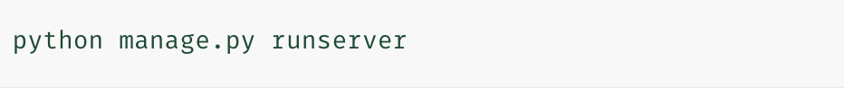
Start development server
First, navigate to “mysite” directory and then run the server
We have started the Django development server, a lightweight web server written purely in Python. We’ve included this with Django so you can develop things rapidly, without having to deal with configuring a production server – such as Apache – until you’re ready for production.
Now that the server’s running, visit http://127.0.0.1:8000/ with your web browser.

Slide 6
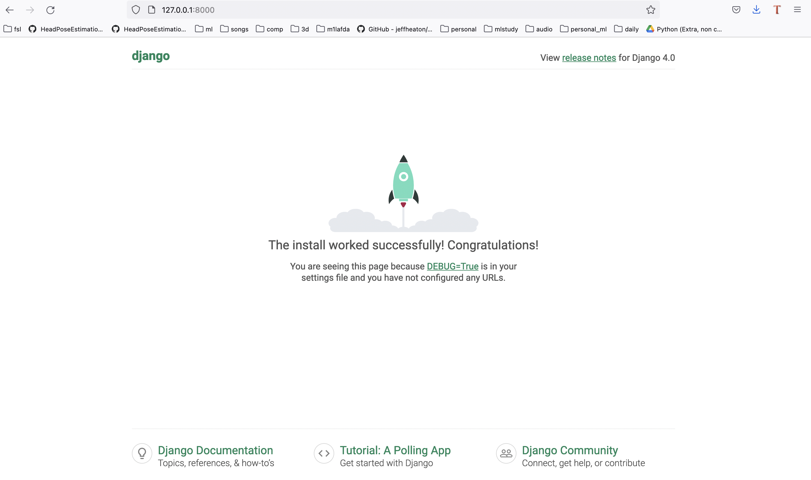

Slide 7
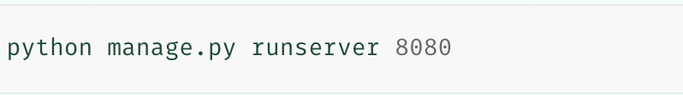
Changing the port
The development server automatically reloads Python code for each request as needed.
You don’t need to restart the server for code changes to take effect.

Slide 8
Now the project is setup, we can create apps to do our work
Each application you write in Django consists of a Python package that follows a certain convention. Django comes with a utility that automatically generates the basic directory structure of an app, so you can focus on writing code rather than creating directories.

Slide 9
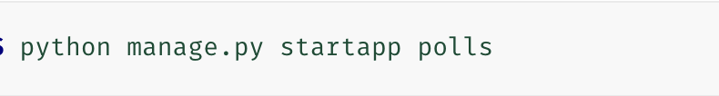
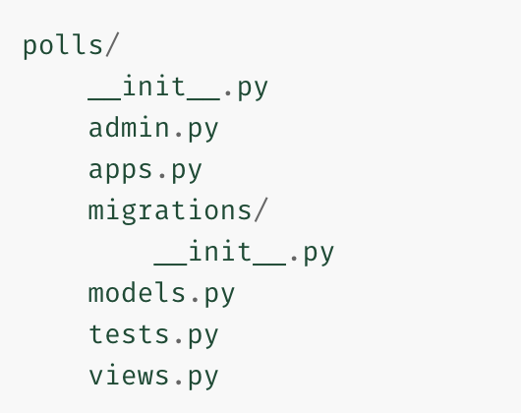
Creating the Polls app
To create your app, make sure you’re in the same directory as manage.py (For comfort: it can be imported as its own top-level module, rather than a submodule of mysite)
That’ll create a directory polls (in right fig)

Slide 10
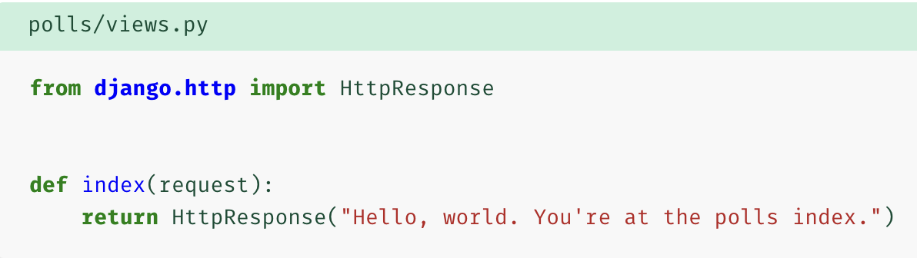
Writing first View
Goto views.py in the polls app directory and write:
This is the simplest view possible in Django. To call the view, we need to map it to a URL - and for this we need a URLconf.
To create a URLconf in the polls directory, create a file called urls.py.

Slide 11
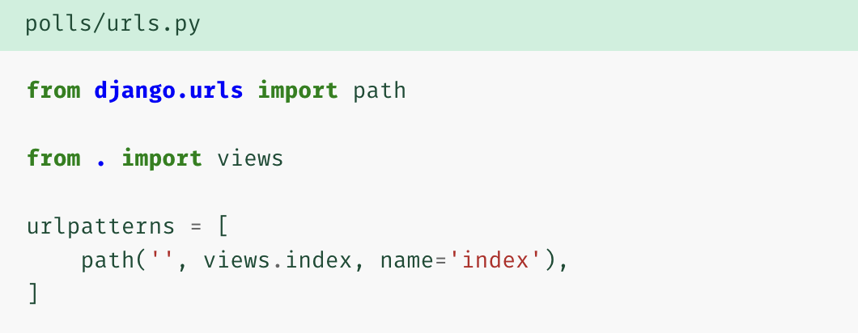
In the polls/urls.py file include the following code:
The next step is to point the root URLconf at the polls.urls module. In mysite/urls.py, add an import for django.urls.include and insert an include() in the urlpatterns list.

Slide 12
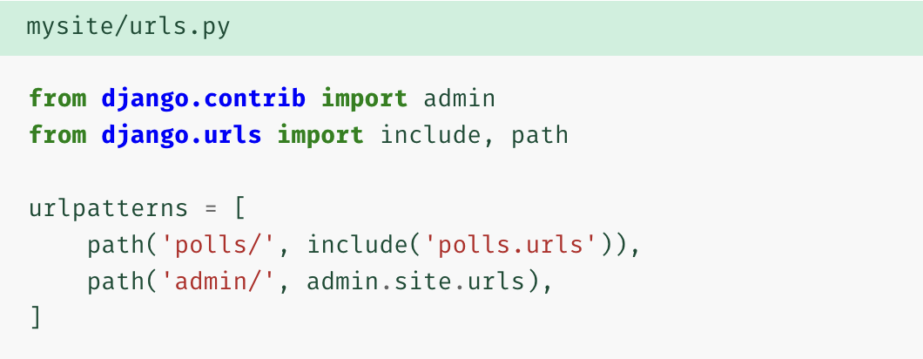
The include() function allows referencing other URLconfs.
The idea behind include() is to make it easy to plug-and-play URLs.
Whenever Django encounters include(), it chops off whatever part of the URL matched up to that point and sends the remaining string to the included URLconf for further processing.
We can see the current view in http://127.0.0.1:8080/polls/ url

Slide 13
The path() function is passed four arguments, two required: route and view, and two optional: kwargs, and name.
Route: route is a string that contains a URL pattern. When processing a request, Django starts at the first pattern in urlpatterns and makes its way down the list, comparing the requested URL against each pattern until it finds one that matches.
View: When Django finds a matching pattern, it calls the specified view function with an HttpRequest object as the first argument and any “captured” values from the route as keyword arguments.
Kwargs: Arbitrary keyword arguments can be passed in a dictionary to the target view. Not used much here.
Name: Naming your URL lets you refer to it unambiguously from elsewhere in Django, especially from within templates. This powerful feature allows you to make global changes to the URL patterns of your project while only touching a single file.

Slide 14
Database, model and django admin
We’ll set up the database, create your first model, and get a quick introduction to Django’s automatically-generated admin site.
DATABASE SETUP
Open mysite/settings.py
By default, the configuration uses SQLite.
SQLite is included in Python, so you won’t need to install anything else to support your database.

Slide 15
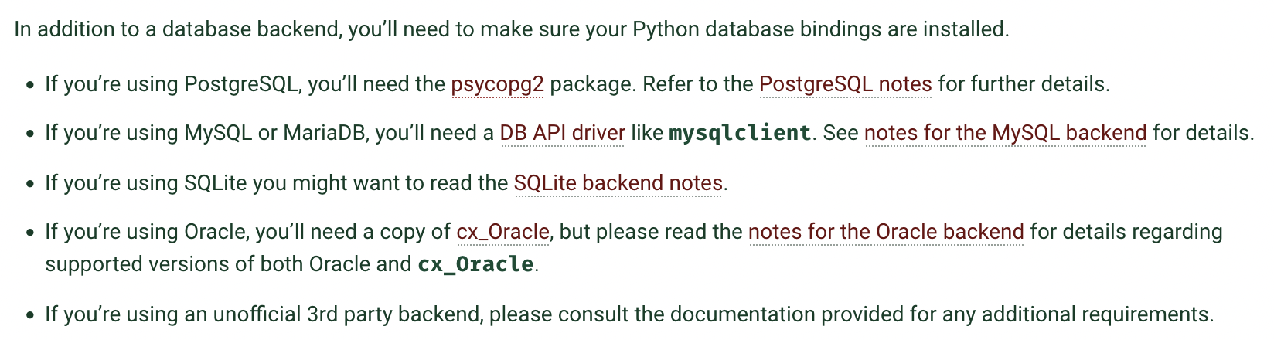
Get your database running

Slide 16
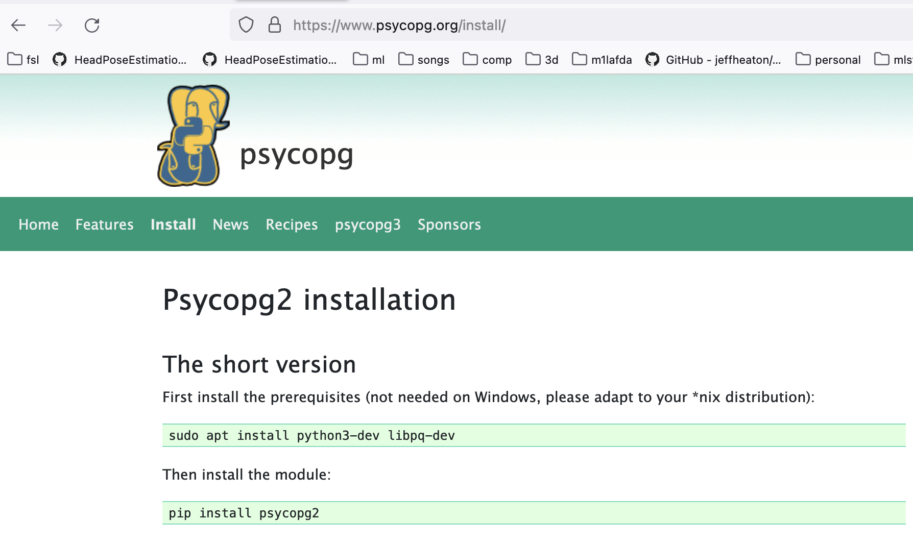
Install psycopg

Slide 17
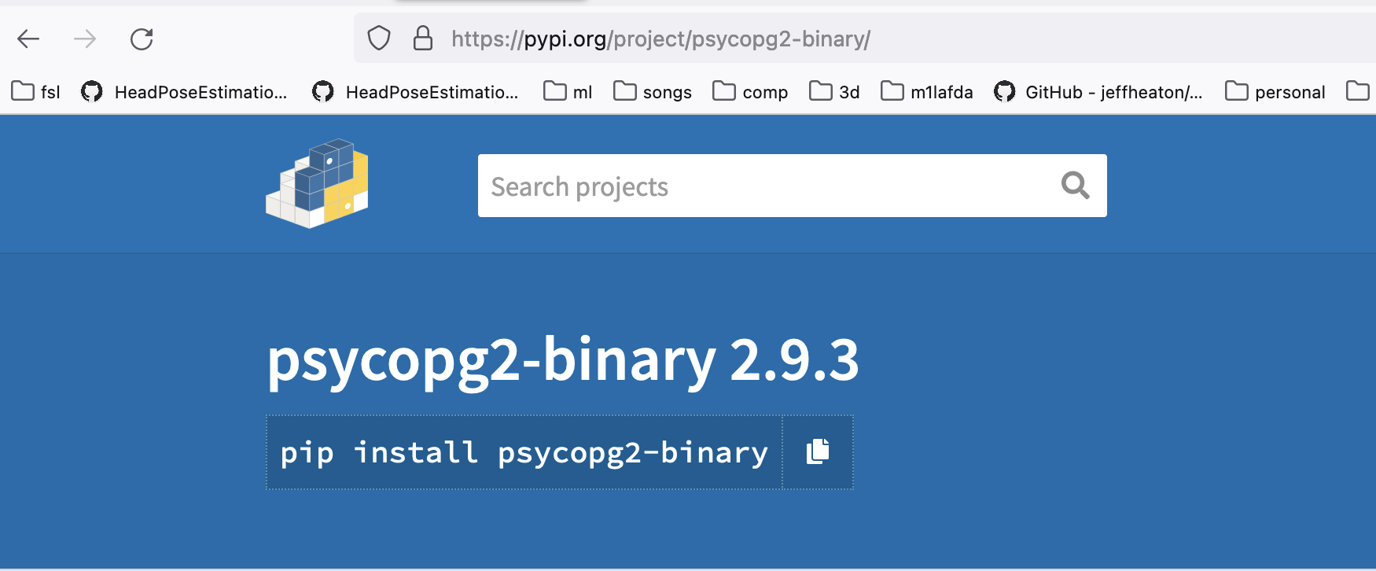

Slide 18
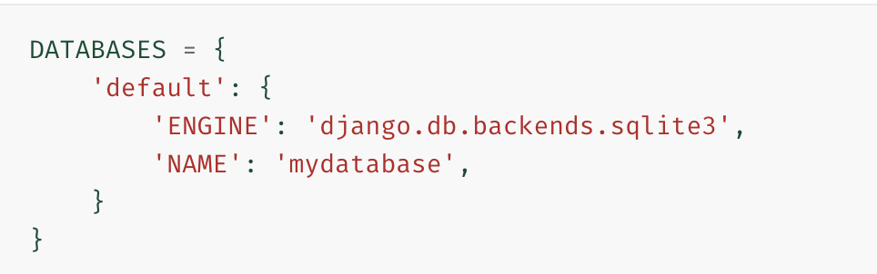
Using SQLite
The simplest possible settings file is for a single-database setup using SQLite.
This can be configured using the following:

Slide 19
No need to create database beforehand if using SQLite.
If using other databases like postgresql, mysql, etc. we need to create database before setting up in mysite/settings.py.
To create database: create database <databasename> in corresponding database

Slide 20
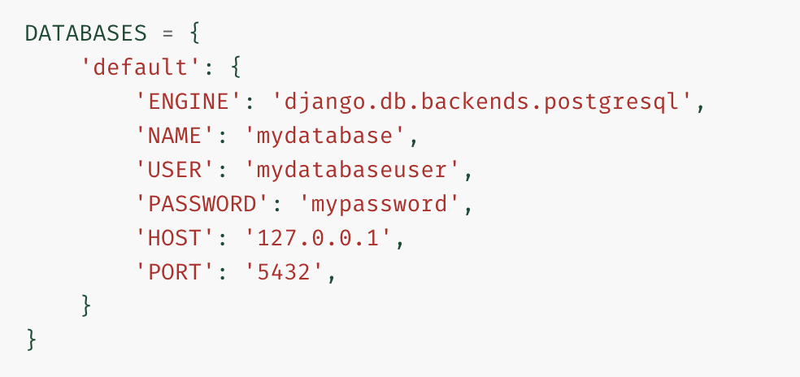
Using PostgreSQL
Name: name of database, user: username in database (in our case: postgres), password: password to login to your
Database, host: localhost or ip to remote database server and port: portnumber. Engine defines which database engine
we are using.

Slide 21
Once db engine is setup, we can migrate the admin tables to database.
Create a database called “polls_db”

Slide 22
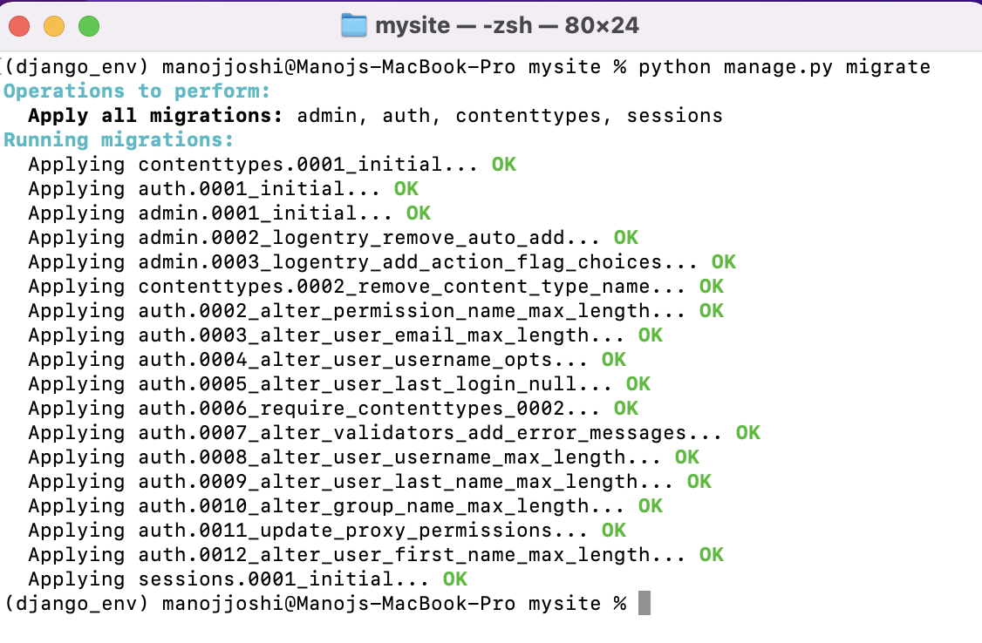
Migrations

Slide 23
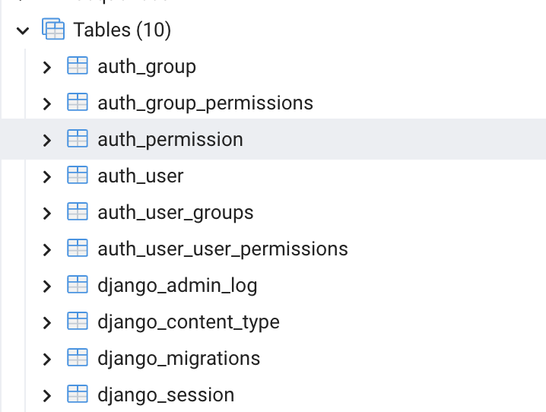
Django admin and auth related tables
The migrate command looks at the INSTALLED_APPS setting and creates any necessary database tables
according to the database settings in your mysite/settings.py file and the database migrations shipped with the app

Slide 24
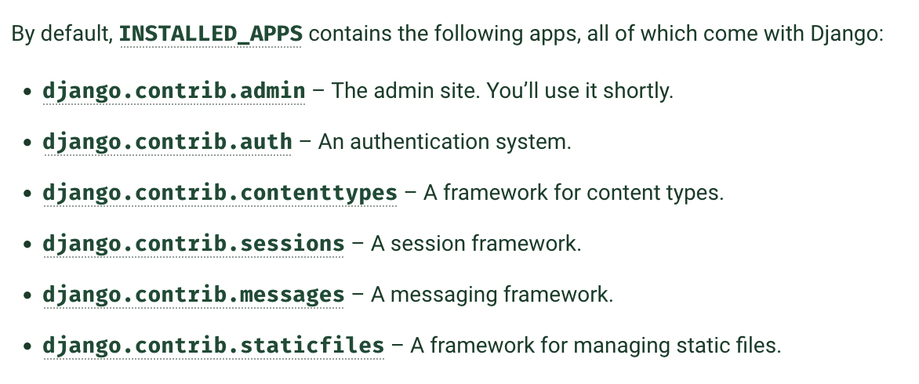
If you don’t need any or all of them, feel free to comment-out or delete the appropriate line(s) from INSTALLED_APPS before running migrate. The migrate command will only run migrations for apps in INSTALLED_APPS.

Slide 25
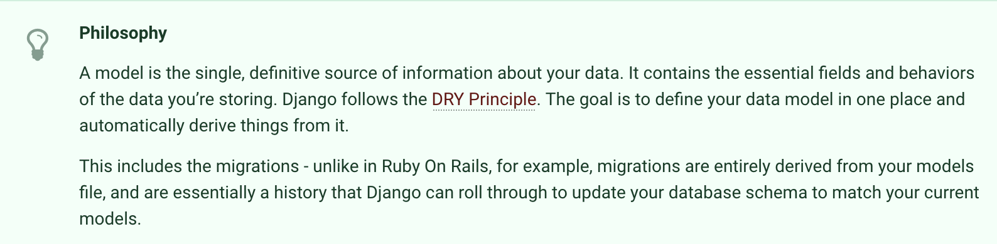
Creating Models
In our poll app, we’ll create two models: Question and Choice.
These concepts are represented by Python classes. Edit the polls/models.py file to create these models.

Slide 26
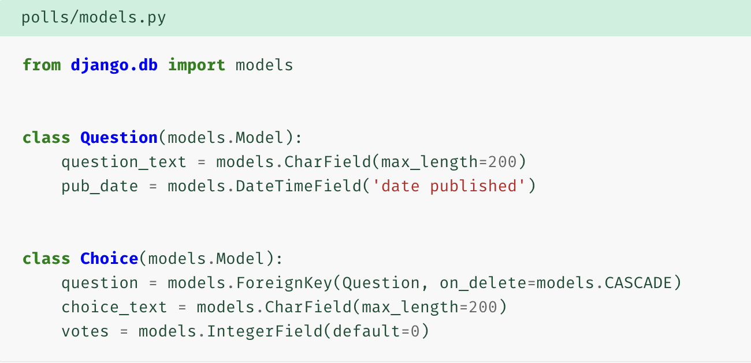

Slide 27
each model is represented by a class that subclasses django.db.models.Model.
Each model has a number of class variables, each of which represents a database field in the model.
Each field is represented by an instance of a Field class – e.g., CharField for character fields and DateTimeField for datetimes. This tells Django what type of data each field holds.
You’ll use this value in your Python code, and your database will use it as the column name.
You can use an optional first positional argument to a Field to designate a human-readable name. In this example, we’ve only defined a human-readable name for Question.pub_date. If this field isn’t provided, Django will use the machine-readable name.

Slide 28
Some Field classes have required arguments. CharField, for example, requires that you give it a max_length. That’s used not only in the database schema, but also in validation.
A Field can also have various optional arguments; in this case, we’ve set the default value of votes to 0.
Note a relationship is defined, using ForeignKey. That tells Django each Choice is related to a single Question. Django supports all the common database relationships: many-to-one, many-to-many, and one-to-one.

Slide 29
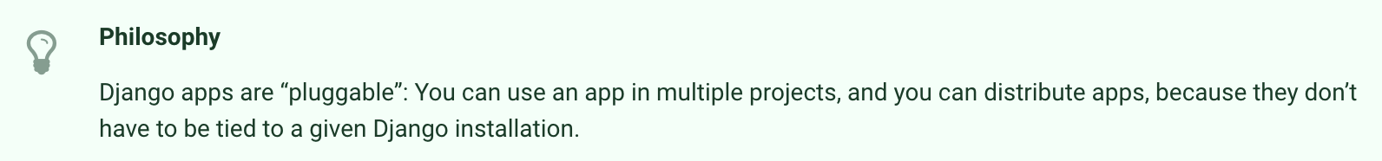
Activating models
That small bit of model code gives Django a lot of information. With it, Django is able to:
Create a database schema (CREATE TABLE statements) for this app.
Create a Python database-access API for accessing Question and Choice objects.
But first we need to tell our project that the polls app is installed.

Slide 30
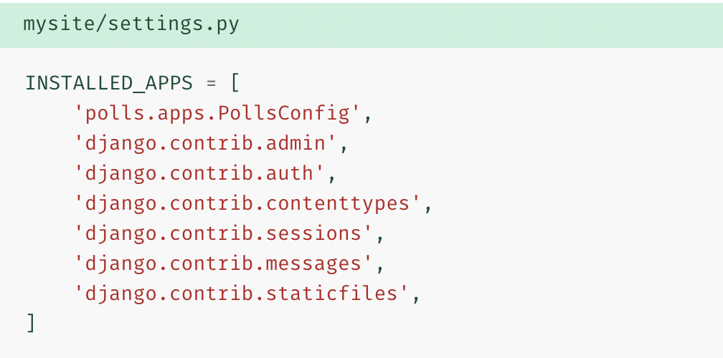
To include the app in our project, we need to add a reference to its configuration class in the INSTALLED_APPS setting.
The PollsConfig class is in the polls/apps.py file, so its dotted path is 'polls.apps.PollsConfig’.
Now Django knows to include the polls app.

Slide 31
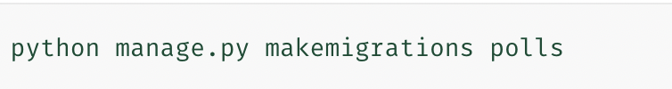
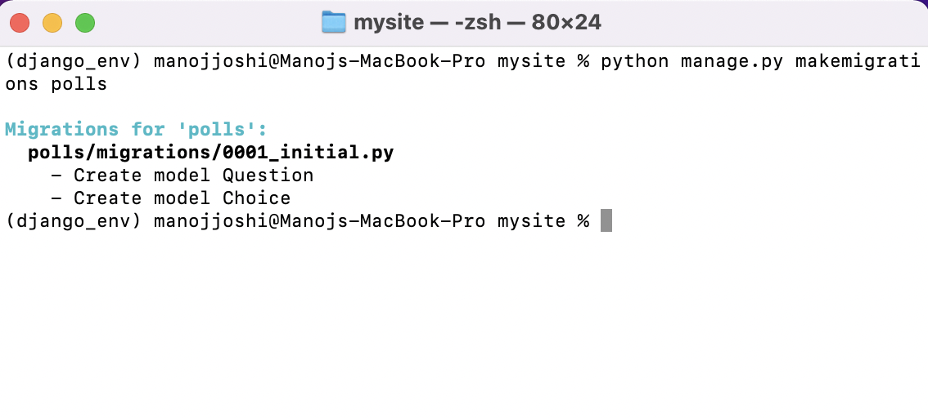
Migrate polls app models to database
will result in:

Slide 32
By running makemigrations, you’re telling Django that you’ve made some changes to your models (in this case, you’ve made new ones) and that you’d like the changes to be stored as a migration.
Migrations are how Django stores changes to your models (and thus your database schema) - they’re files on disk. You can read the migration for your new model if you like; it’s the file polls/migrations/0001_initial.py.
There’s a command that will run the migrations for you and manage your database schema automatically - that’s called migrate.
The sqlmigrate command takes migration names and returns their SQL:

Slide 33
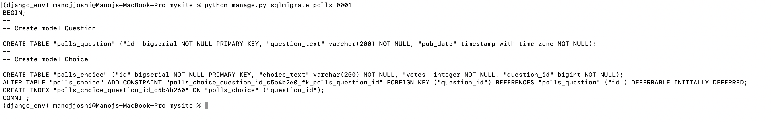
The sqlmigrate command doesn’t actually run the migration on your database - instead,
it prints it to the screen so that you can see what SQL Django thinks is required.

Slide 34
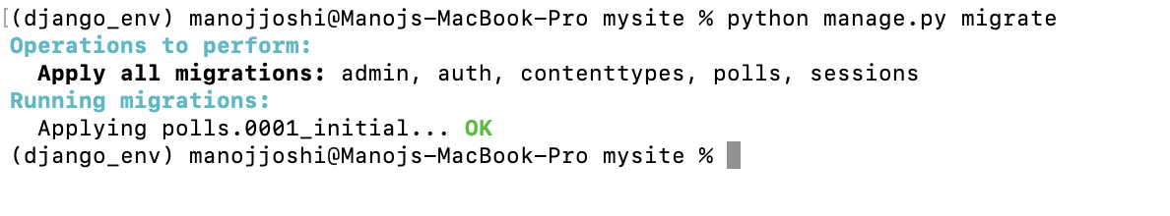
Migrate to database:
run migrate again to create those model tables in your database:
We now actually created tables in the database:

Slide 35
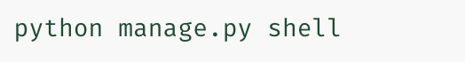
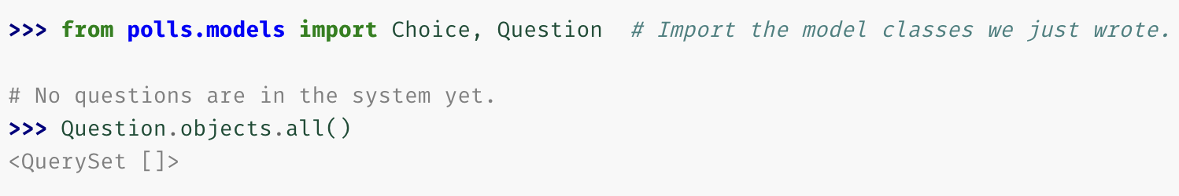
Playing with the database API
Run python shell where we can use database API.

Slide 36
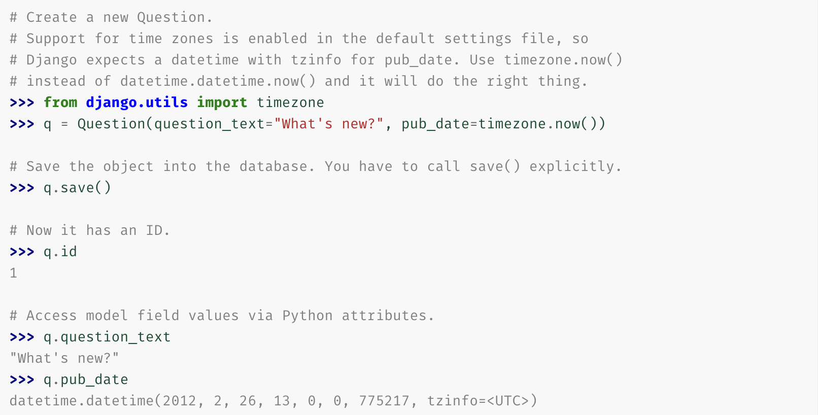

Slide 37
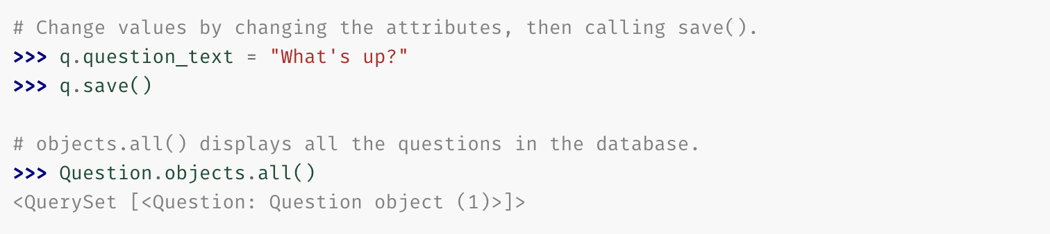
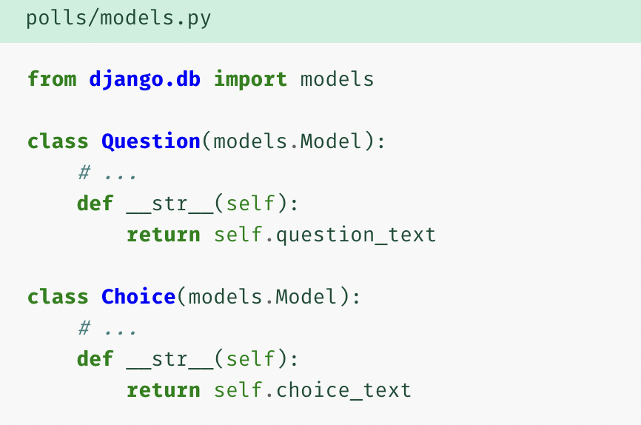
Wait a minute. <Question: Question object (1)> isn’t a helpful representation of this object. Let’s fix that by editing the Question model (in the polls/models.py file) and adding a __str__() method to both Question and Choice:

Slide 38
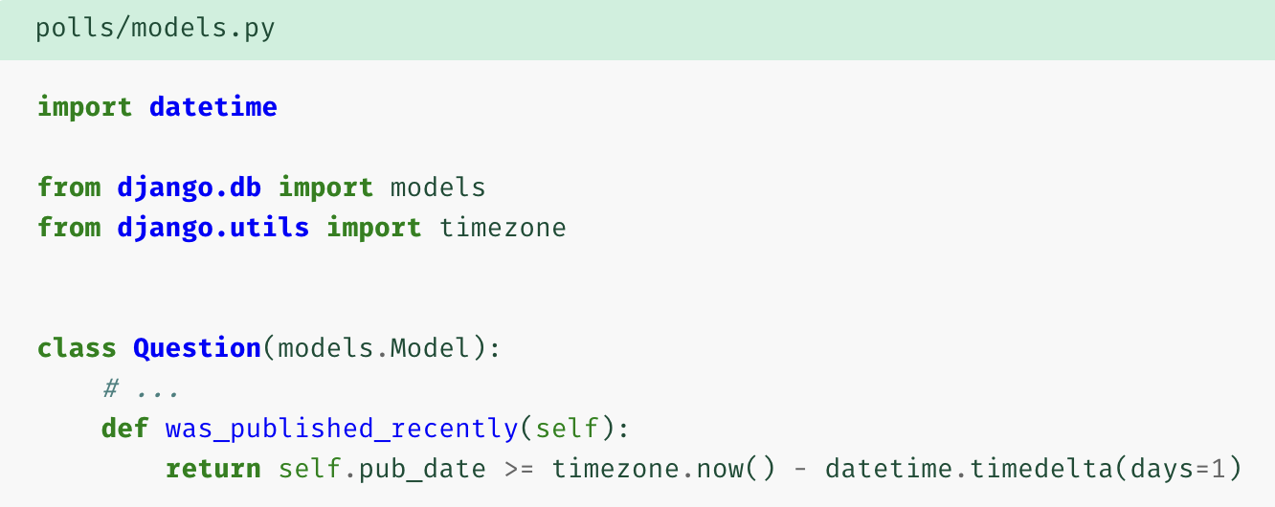
It’s important to add __str__() methods to your models, not only for your own convenience when dealing with the interactive prompt, but also because objects’ representations are used throughout Django’s automatically-generated admin.
Let’s also add a custom method to this model:

Slide 39
Note the addition of import datetime and from django.utils import timezone, to reference Python’s standard datetime module and Django’s time-zone-related utilities in django.utils.timezone, respectively.
Start python shell again: python manage.py shell

Slide 40
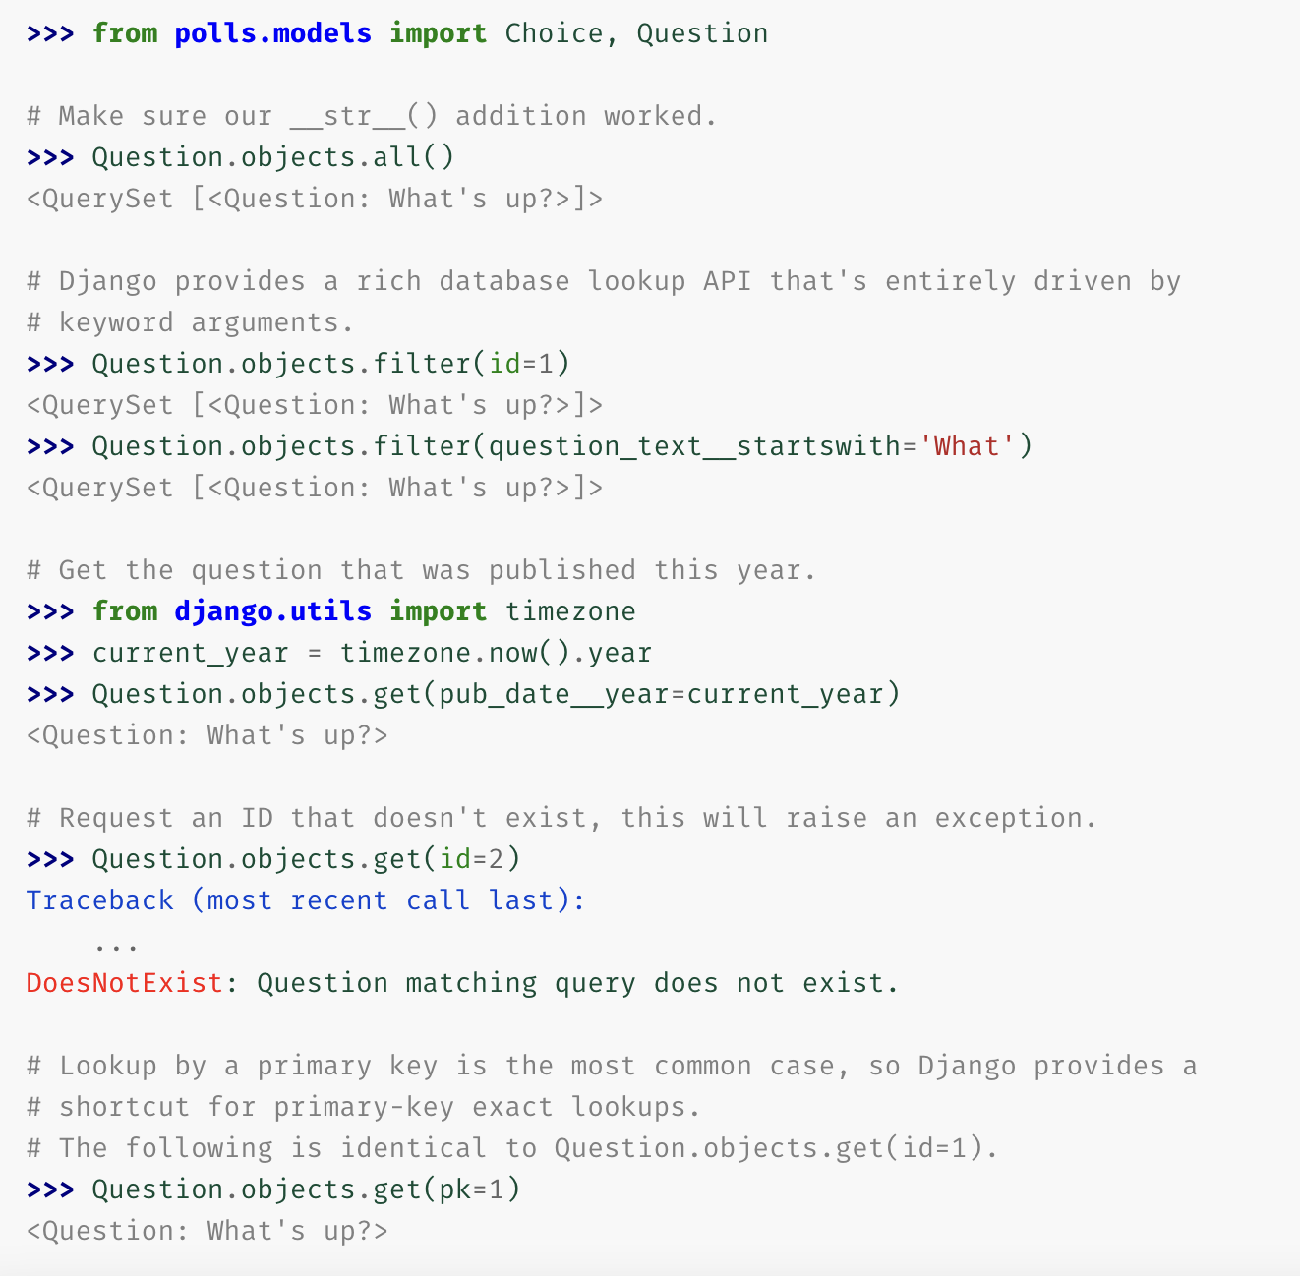

Slide 41
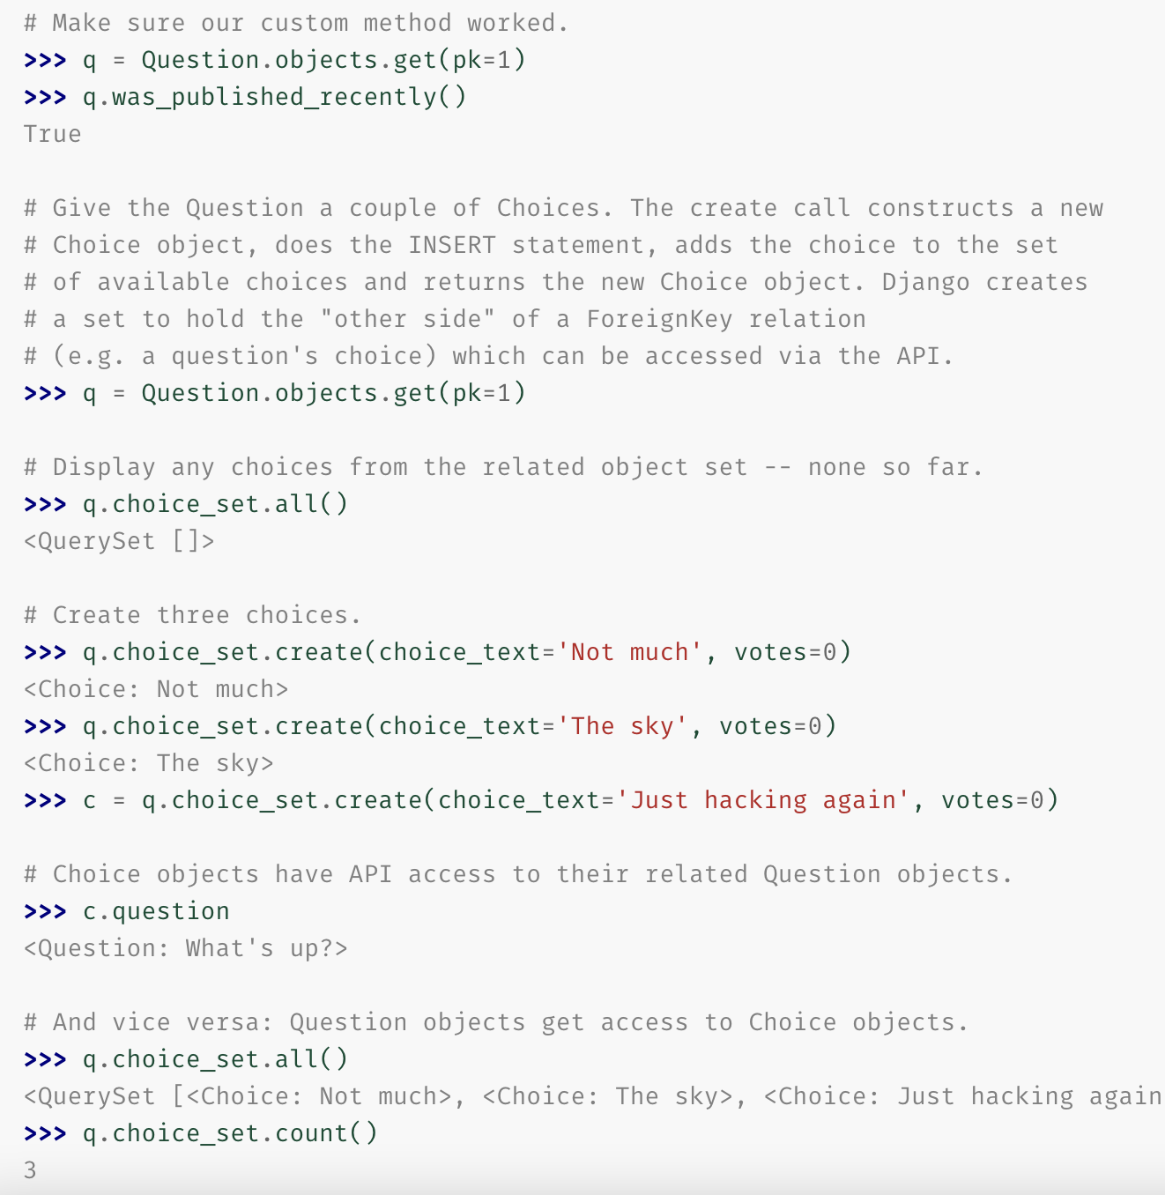

Slide 42
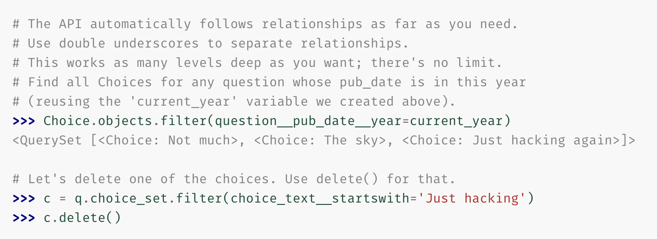

Slide 43
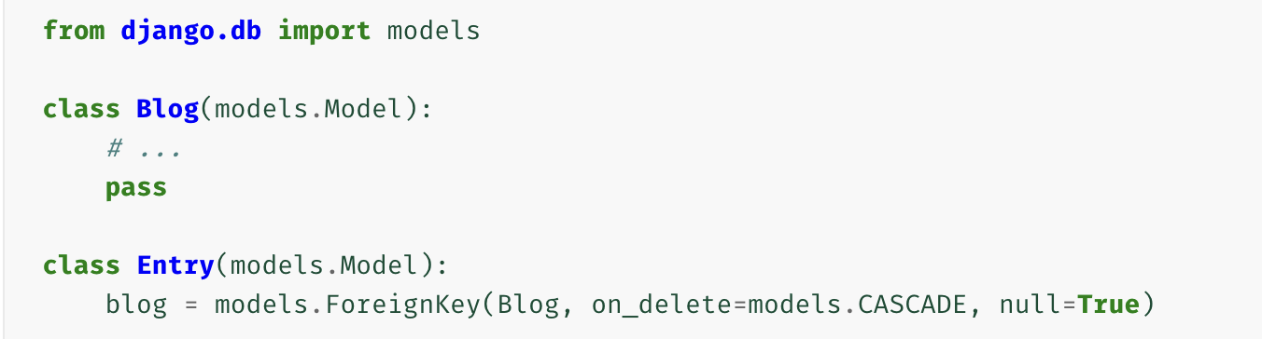
Related objects reference
A “related manager” is a manager used in a one-to-many or many-to-many related context. This happens in two cases:
The “other side” of a ForeignKey relation. That is:
In the above example, the methods below will be available on the manager blog.entry_set.

Slide 44
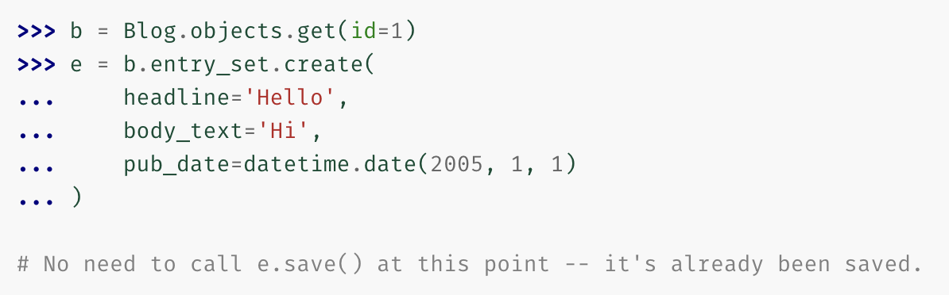
Create(): Creates a new object, saves it and puts it in the related object set. Returns the newly created object:

Slide 45
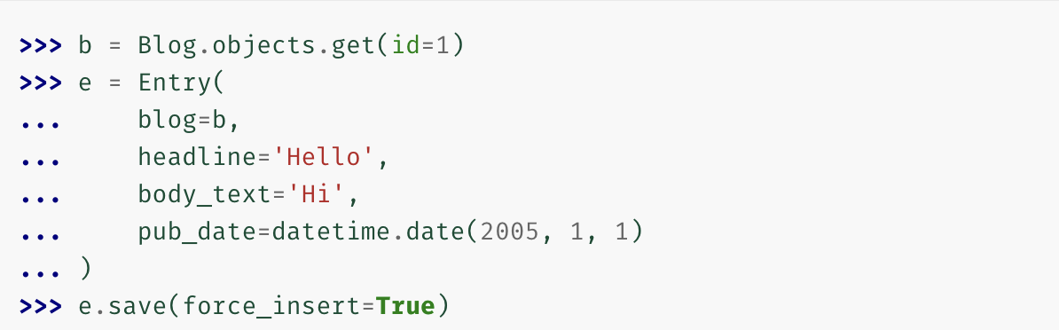
Create is equivalent to doing something like this:
For delete: b = Blog.objects.get(id = 1)
e = Entry.objects.get(id=2)
b.entry_set.get(id=2).delete()

Slide 46
Field lookups
Field lookups are how you specify the meat of an SQL WHERE clause.
They’re specified as keyword arguments to the QuerySet methods filter(), exclude() and get().
Basic lookups keyword arguments take the form field__lookuptype=value. (That’s a double-underscore).
Eqvt to: SELECT * FROM blog_entry WHERE pub_date <= '2006-01-01’;

Slide 47
The field specified in a lookup has to be the name of a model field.
There’s one exception though, in case of a ForeignKey you can specify the field name suffixed with _id.
There are many lookup types. Few most used are: exact,iexact, contains,startswith, endswith, etc.
Exact Match : SELECT ... WHERE headline = 'Cat bites dog';

Slide 48
Case sensitive match:
Would match a Blog titled "Beatles Blog", "beatles blog", or even "BeAtlES blOG".
Case-sensitive containment test: SELECT ... WHERE headline LIKE '%Lennon%’;
Note this will match the headline 'Today Lennon honored' but not 'today lennon honored’. There’s also a case-insensitive version, icontains.

Slide 49
Lookups that span relationships
Django offers a powerful and intuitive way to “follow” relationships in lookups, taking care of the SQL JOINs for you automatically, behind the scenes.
To span a relationship, use the field name of related fields across models, separated by double underscores, until you get to the field you want.
This example retrieves all Entry objects with a Blog whose name is 'Beatles Blog':

Slide 50
It works backwards, too.
This example retrieves all Blog objects which have at least one Entry whose headline contains 'Lennon':
If you are filtering across multiple relationships and one of the intermediate models doesn’t have a value that meets the filter condition, Django will treat it as if there is an empty (all values are NULL), but valid, object there.
All this means is that no error will be raised. For example, in this filter:

Slide 51
Spanning multi-valued relationships
To select all blogs containing at least one entry from 2008 having “Lennon” in its headline (the same entry satisfying both conditions), we would write:
Otherwise, to perform a more permissive query selecting any blogs with merely some entry with “Lennon” in its headline and some entry from 2008, we would write:

Slide 52
Django-Admin
Philosophy
Generating admin sites for your staff or clients to add, change, and delete content is tedious work that doesn’t require much creativity. For that reason, Django entirely automates creation of admin interfaces for models.
The admin isn’t intended to be used by site visitors. It’s for site managers.

Slide 53
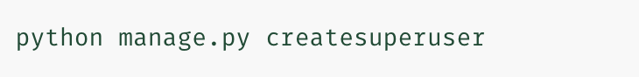
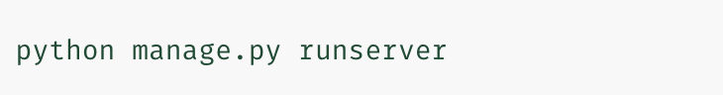
Creating an admin user:
First we’ll need to create a user who can login to the admin site:
Enter your desired username and press enter, desired email address and press enter
The final step is to enter your password. You will be asked to enter your password twice, the second time as a confirmation of the first.

Slide 54
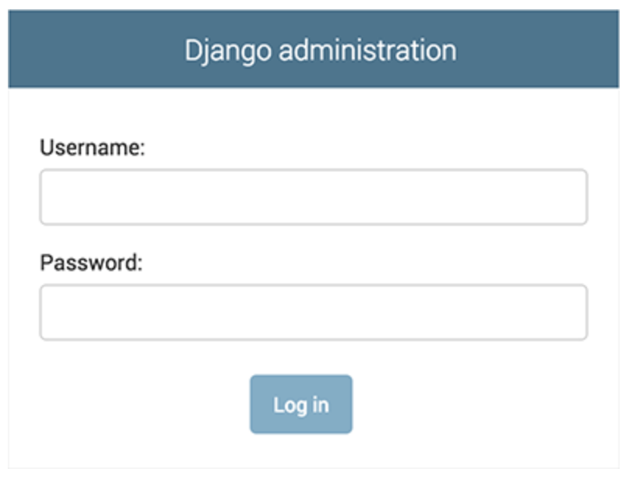
Goto : http://127.0.0.1:8000/admin/

Slide 55
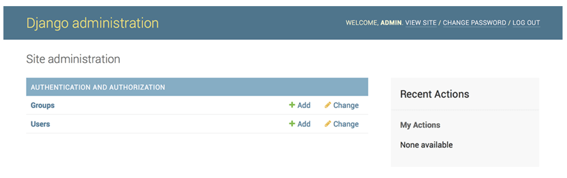
Login with the username and password we have set earlier:
You should see a few types of editable content: groups and users. They are provided by django.contrib.auth, the authentication framework shipped by Django.

Slide 56
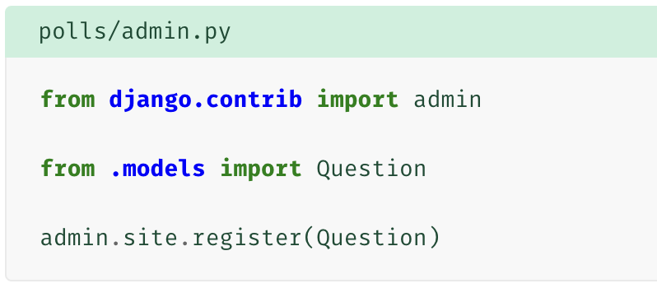
Make the poll app modifiable in the admin
But where’s our poll app? It’s not displayed on the admin index page.
Only one more thing to do: we need to tell the admin that Question objects have an admin interface.
To do this, open the polls/admin.py file, and edit it to look like this:

Slide 57
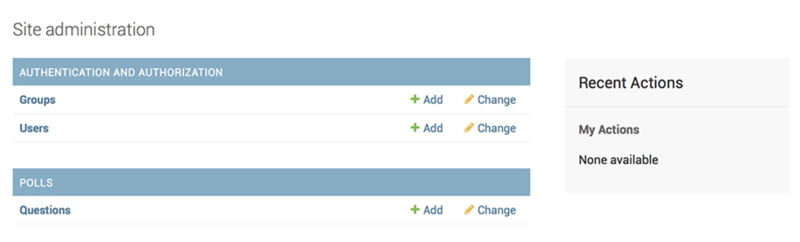
Refresh the admin page:

Slide 58
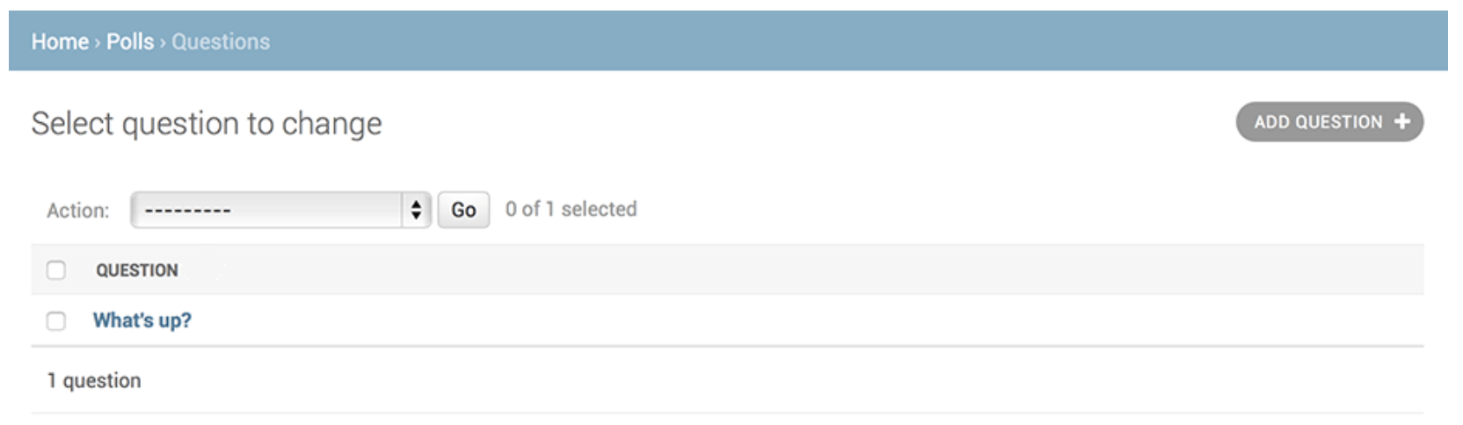
Click “Questions”. Now you’re at the “change list” page for questions.
This page displays all the questions in the database and lets you choose one to change it.

Slide 59
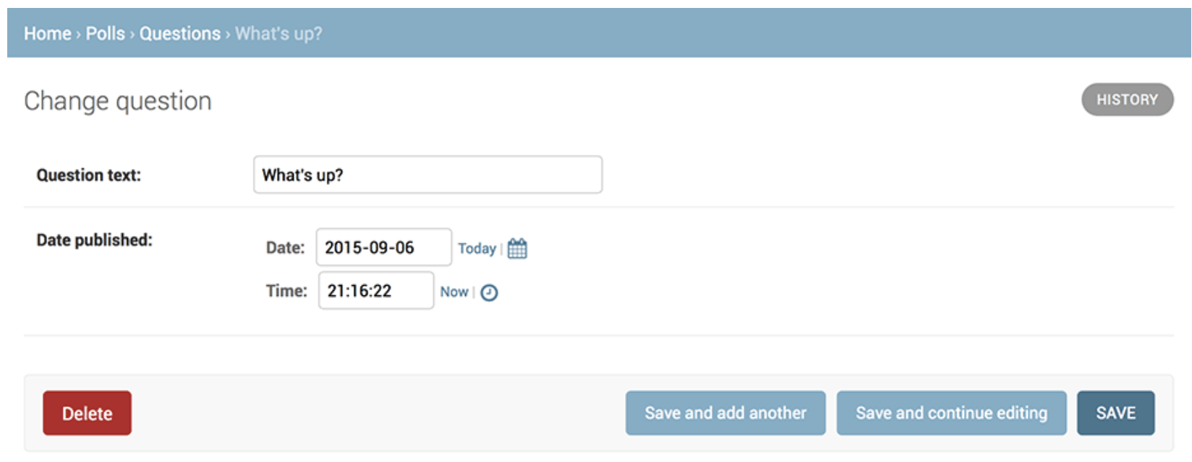
Click the “What’s up?” question to edit it:

Slide 60
The form is automatically generated from the Question model.
The different model field types (DateTimeField, CharField) correspond to the appropriate HTML input widget. Each type of field knows how to display itself in the Django admin.

Slide 61
Views
A view is a “type” of web page in your Django application that generally serves a specific function and has a specific template.
A simple BLOG app may have following views:
Blog homepage – displays the latest few entries.
Entry “detail” page – permalink page for a single entry.
Year-based archive page – displays all months with entries in the given year.
Month-based archive page – displays all days with entries in the given month.
Day-based archive page – displays all entries in the given day.
Comment action – handles posting comments to a given entry.

Slide 62
In our poll application, we’ll have the following four views:
Question “index” page – displays the latest few questions.
Question “detail” page – displays a question text, with no results but with a form to vote.
Question “results” page – displays results for a particular question.
Vote action – handles voting for a particular choice in a particular question.
In Django, web pages and other content are delivered by views.

Slide 63
Each view is represented by a Python function (or method, in the case of class-based views).
Django will choose a view by examining the URL that’s requested (to be precise, the part of the URL after the domain name).
To get from a URL to a view, Django uses what are known as ‘URLconfs’. A URLconf maps URL patterns to views.

Slide 64
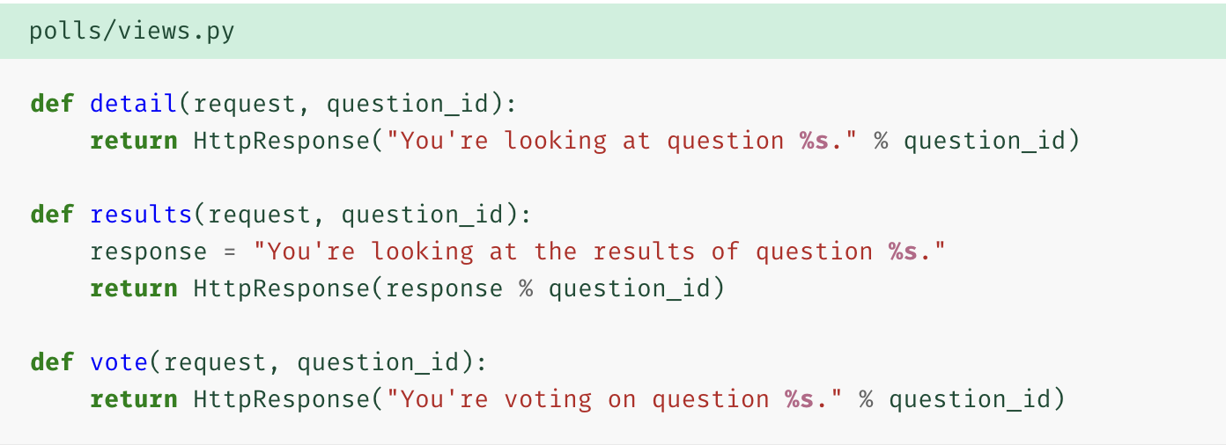
Lets add views

Slide 65
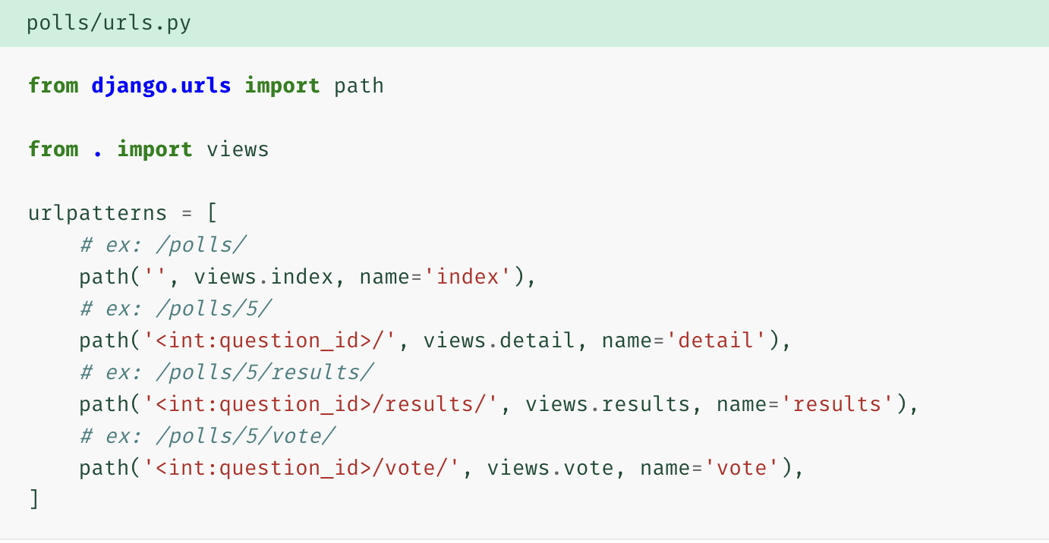
Wire these new views into the polls.urls module by adding the following path() calls:

Slide 66
When somebody requests a page from your website – say, “/polls/34/”, Django will load the mysite.urls Python module because it’s pointed to by the ROOT_URLCONF setting. It finds the variable named urlpatterns and traverses the patterns in order. After finding the match at 'polls/', it strips off the matching text ("polls/") and sends the remaining text – "34/" – to the ‘polls.urls’ URLconf for further processing. There it matches '<int:question_id>/', resulting in a call to the detail() view like so:

Slide 67
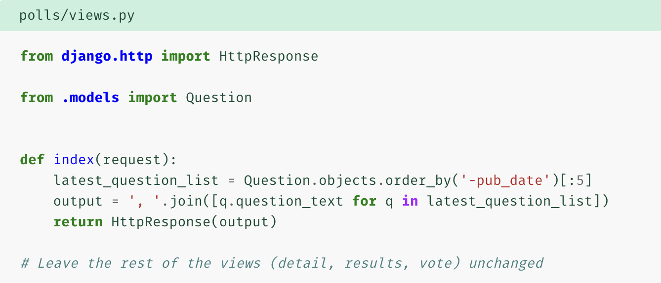
Logic in views
Each view is responsible for doing one of two things: returning an HttpResponse object containing the content for the requested page, or raising an exception such as Http404. The rest is up to you.
All Django wants is that HttpResponse. Or an exception.

Slide 68
Creating templates
HTTPResponse is not so UI friendly. We need templates.
First, create a directory called templates in your polls directory. Django will look for templates in there.
Your project’s TEMPLATES setting describes how Django will load and render templates. The default settings file configures a DjangoTemplates backend whose APP_DIRS option is set to True. By convention DjangoTemplates looks for a “templates” subdirectory in each of the INSTALLED_APPS.
Within the templates directory you have just created, create another directory called polls, and within that create a file called index.html. In other words, your template should be at polls/templates/polls/index.html.

Slide 69

Put some html in templates

Slide 70

Now let’s update our index view in polls/views.py to use the template:
That code loads the template called polls/index.html and passes it a context. The context is a dictionary mapping template variable names to Python objects.

Slide 71

Shortcut to render viewer:

Slide 72

Raising a 404 error
The new concept here: The view raises the Http404 exception if a question with the requested ID doesn’t exist

Slide 73

It’s a very common idiom to use get() and raise Http404 if the object doesn’t exist. Django provides a shortcut. Here’s the detail() view, rewritten:

Slide 74
The get_object_or_404() function takes a Django model as its first argument and an arbitrary number of keyword arguments, which it passes to the get() function of the model’s manager. It raises Http404 if the object doesn’t exist.
There’s also a get_list_or_404() function, which works just as get_object_or_404() – except using filter() instead of get(). It raises Http404 if the list is empty.

Slide 75

Detail view

Slide 76
Variables:
Tags:

Slide 77
Comments:
Hard-coded urls can be changed to better ones:

Slide 78
The way this works is by looking up the URL definition as specified in the polls.urls module. You can see exactly where the URL name of ‘detail’ is defined below:
If you want to change the URL of the polls detail view to something else, perhaps to something like polls/specifics/12/ instead of doing it in the template (or templates) you would change it in polls/urls.py:

Slide 79
Namespacing URL names
The tutorial project has just one app, polls. In real Django projects, there might be five, ten, twenty apps or more. How does Django differentiate the URL names between them? For example, the polls app has a detail view, and so might an app on the same project that is for a blog. How does one make it so that Django knows which app view to create for a url when using the {% url %} template tag?
The answer is to add namespaces to your URLconf. In the polls/urls.py file, go ahead and add an app_name to set the application namespace:

Slide 80


Slide 81


Now change your polls/index.html template from:
TO:

Slide 82


Slide 83

Add the following to polls/views.py:

Slide 84
request.POST is a dictionary-like object that lets you access submitted data by key name. In this case, request.POST['choice'] returns the ID of the selected choice, as a string. request.POST values are always strings.
request.POST['choice'] will raise KeyError if choice wasn’t provided in POST data. The above code checks for KeyError and redisplays the question form with an error message if choice isn’t given.
After incrementing the choice count, the code returns an HttpResponseRedirect rather than a normal HttpResponse. HttpResponseRedirect takes a single argument: the URL to which the user will be redirected (see the following point for how we construct the URL in this case).

Slide 85
You should always return an HttpResponseRedirect after successfully dealing with POST data. This tip isn’t specific to Django; it’s good web development practice in general.
We are using the reverse() function in the HttpResponseRedirect constructor in this example. This function helps avoid having to hardcode a URL in the view function. It is given the name of the view that we want to pass control to and the variable portion of the URL pattern that points to that view.

Slide 86

After somebody votes in a question, the vote() view redirects to the results page for the question. Let’s write that view:

Slide 87

Now, create a polls/results.html template:

Slide 88
Use generic views: Less code is better
These views represent a common case of basic web development: getting data from the database according to a parameter passed in the URL, loading a template and returning the rendered template. Because this is so common, Django provides a shortcut, called the “generic views” system.
Let’s convert our poll app to use the generic views system, so we can delete a bunch of our own code. We’ll have to take a few steps to make the conversion. We will:
Convert the URLconf.
Delete some of the old, unneeded views.
Introduce new views based on Django’s generic views.

Slide 89

First, open the polls/urls.py URLconf and change it like so:

Slide 90

Next, we’re going to remove our old index, detail, and results views and use Django’s generic views instead. To do so, open the polls/views.py file and change it like so:

Slide 91
We’re using two generic views here: ListView and DetailView. Respectively, those two views abstract the concepts of “display a list of objects” and “display a detail page for a particular type of object.”
Each generic view needs to know what model it will be acting upon. This is provided using the model attribute.
The DetailView generic view expects the primary key value captured from the URL to be called "pk", so we’ve changed question_id to pk for the generic views.

Slide 92
Aside from the HTML generated by the server, web applications generally need to serve additional files — such as images, JavaScript, or CSS — necessary to render the complete web page. In Django, we refer to these files as “static files”.
For small projects, this isn’t a big deal, because you can keep the static files somewhere your web server can find it. However, in bigger projects – especially those comprised of multiple apps – dealing with the multiple sets of static files provided by each application starts to get tricky.
That’s what django.contrib.staticfiles is for: it collects static files from each of your applications (and any other places you specify) into a single location that can easily be served in production.

Slide 93

First, create a directory called static in your polls directory. Django will look for static files there, similarly to how Django finds templates inside polls/templates/.
Within the static directory you have just created, create another directory called polls and within that create a file called style.css. In other words, your stylesheet should be at polls/static/polls/style.css.
Put the following code in that stylesheet (polls/static/polls/style.css):

Slide 94

Next, add the following at the top of polls/templates/polls/index.html:

